Slide 1
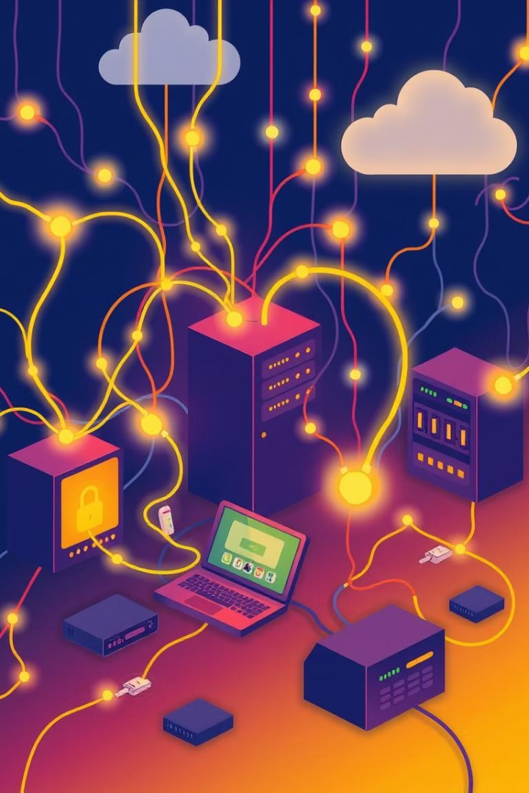
CLASS 12 COMPUTER NETWORKS VIRUSES: TROJAN HORSE,WORMS,SPAM,MALWARE AND NETWORK SECURITY THREATS
This presentation will explore the types, characteristics, and impacts of computer viruses, including Trojan horses, worms, and spam. We'll also cover the crucial aspects of network security and virus prevention.

Slide 2
Introduction to Computer Viruses
Definition
Evolution
Computer viruses are malicious programs designed to spread from one computer to another, disrupting operations, stealing data, or causing damage.
Viruses have evolved over time, becoming increasingly sophisticated and difficult to detect and prevent.

Slide 3

Types of Viruses: Trojan Horse, Worms, Spyware, Ransomware
Trojan Horse
Worms
Disguised as legitimate software, these viruses harm your system once installed.
Self-replicating viruses that spread through networks without user interaction.
Spyware
Ransomware
Monitors your online activity, stealing your personal data and sending it to hackers.
Locks your files and demands payment to unlock them.

Slide 4
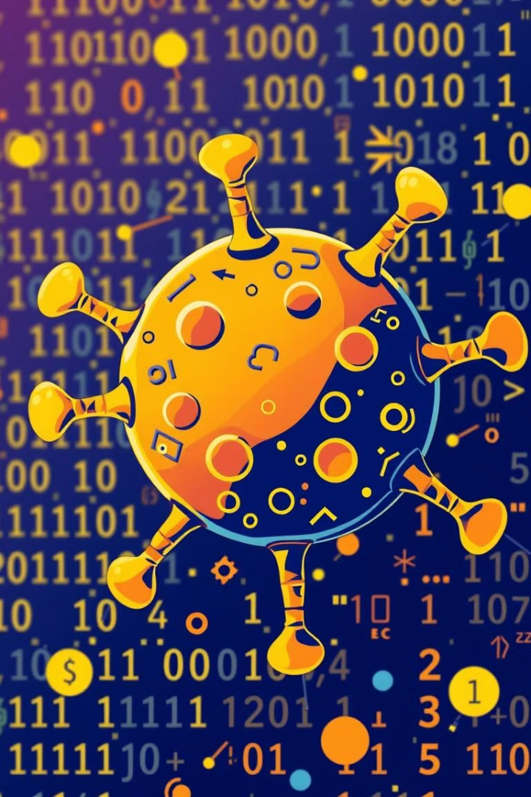
Characteristics and Behaviors of Viruses
Replication
Infection
Viruses spread by creating copies of themselves, infecting other files or programs.
They insert their code into existing programs or files, altering their functionality.
Activation
Payload
They may activate under specific conditions, such as opening a file or launching a program.
They carry a malicious payload, which can range from data theft to system damage.

Slide 5




Trojan Horse Attacks: How They Work and Impact
Installation
Payload Activation
Hacker Control
Trojans are disguised as legitimate software, tricking users into installing them.
Once installed, the Trojan's hidden payload activates, causing damage or theft.
Hackers can remotely control the infected system, stealing data or launching attacks.

Slide 6
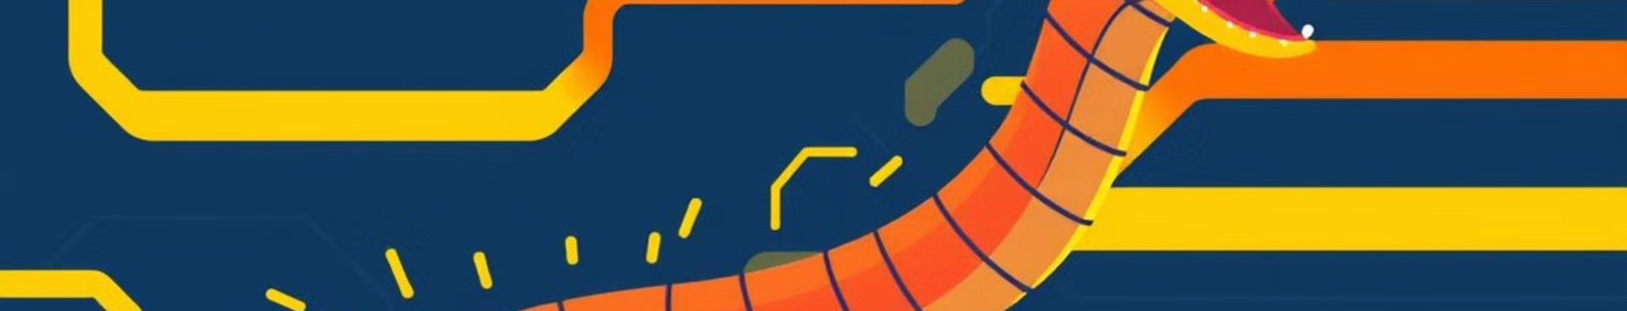
Worms: Self-Replicating Malware and Network Propagation
1
2
3
Entry Point
Replication
Payload Delivery
Worms exploit vulnerabilities in network systems to gain entry.
They spread by copying themselves to other devices on the network.
Worms carry a payload that can damage systems or steal data.

Slide 7
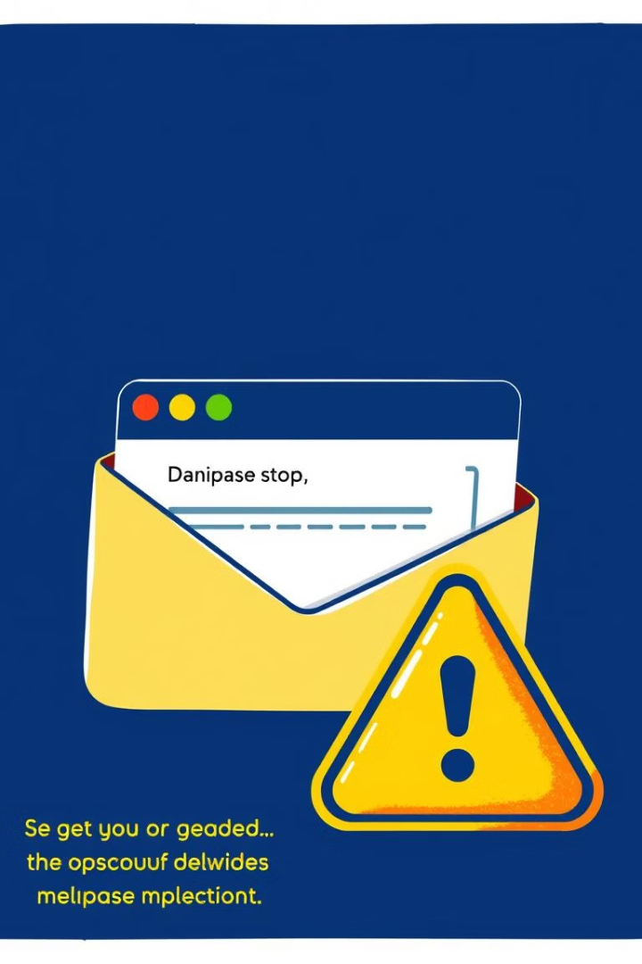
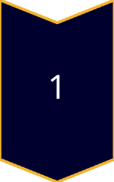

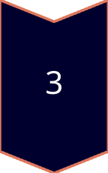
Spam and Malware: Threats to Email and Online Security
Spam Emails
Unwanted bulk emails, often containing malicious links.
Malware Attachments
Infected files attached to emails, disguised as legitimate content.
Phishing Attacks
Emails designed to trick users into revealing sensitive information.

Slide 8





Strategies for Network Security and Virus Prevention
Antivirus Software
1
Detects and removes viruses from your computer.
2
Firewalls
Act as a barrier between your computer and the internet.
3
Strong Passwords
Use complex passwords that are difficult to guess.
4
Software Updates
Keep your operating system and software up to date.
5
Security Awareness
Educate yourself on the latest threats and how to protect yourself.

